Slide 1
Predicting House Prices Machine Learning
Presenter,
Rakshit Siddalingappa - 11012530
Mentors,
Dr. Simon Ziegler
Sebastian Strubert

Slide 2
Agenda
Tools Used
Project Problem & Solution
Datasets Source & Variables
Datasets Processing
Linear Regression & Random Forest Analysis
Technologies & Tools
Architecture (Project Flow)
Result

Slide 3
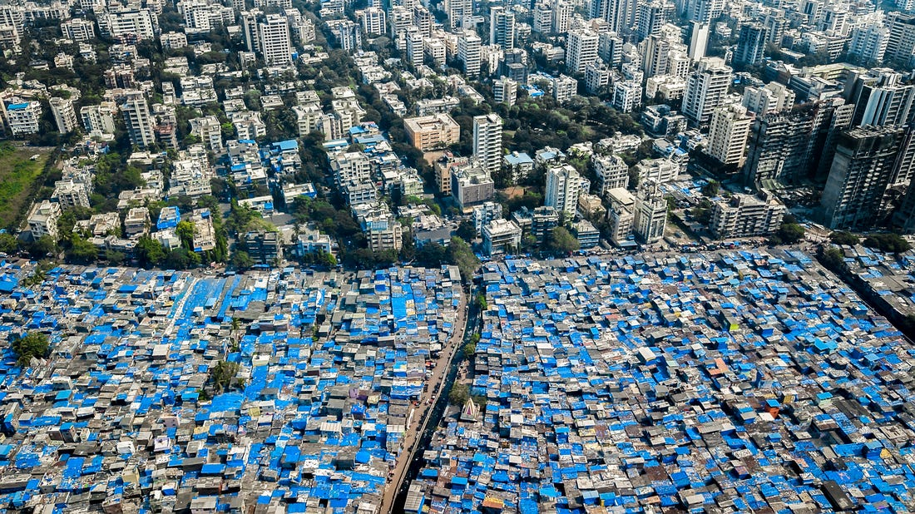

Project Problem

Slide 4
Project Problem & Solution
My project helps people to find their dream house in Mumbai, India when they want to Buy, Rent, Lease.
Challenge – Build a Machine Learning model using Datasets wherein anyone can predict the house price from remote area at any time.
Solution - Predicting House Price sector wise amongst N number of properties with approximate prices.

Slide 5
About Datasets Source & Variables
We are referring to the datasets which we have roughly created using several market places websites like 99acres, Housing.com, MagicBricks, NestAway, QuikrHome.
We have improvised the datasets by adding necessary data columns which will be useful for predicting accurate prices.
The dataset contains 8 columns of attributes & 859 row sample records.

Slide 6
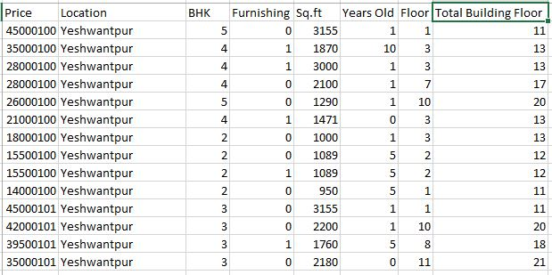
About Datasets Source & Variables

Slide 7
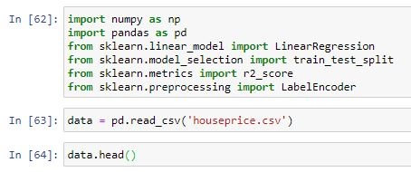
Datasets Processing
Using Library Packages to process the Dataset & To read the dataset file.
Notes:
NumPy is a general-purpose array-processing package. It provides a high-performance multidimensional array object, and tools for working with these arrays. It is the fundamental package for scientific computing with Python
It provides high-performance, easy to use structures and data analysis tools.
NumPy library which provides objects for multi-dimensional arrays
Pandas provides in-memory 2d table object called Dataframe.
Pandas is the most widely used tool for data munging. It contains high-level data structures and manipulation tools designed to make data analysis fast and easy.
Data Munging - extracting the data in a raw form from the data source.
Munging the raw data using algorithms (e.g. sorting) or parsing the data into predefined data structures, and finally depositing the resulting content into a data sink for storage and future use.
Sklearn - is a free machine learning library for Python. It features various algorithms like support vector machine, random forests, and k-neighbours, and it also supports Python numerical and scientific libraries like NumPy and SciPy.

Slide 8
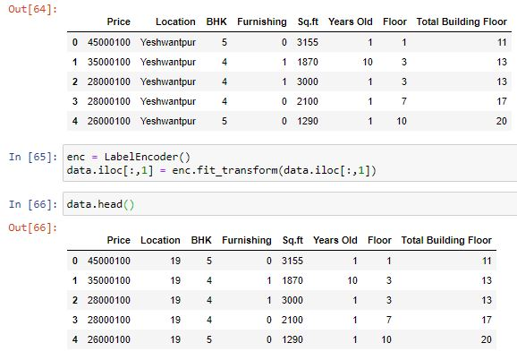
Datasets Processing
Setting up a Location Variable (String) column as Labelled Data.
Notes:
Label Encoding refers to converting the labels into numeric form so as to convert it into the machine-readable form.
Label Encoding in Python can be achieved using Sklearn Library. Sklearn provides a very efficient tool for encoding the levels of categorical features into numeric values.

Slide 9
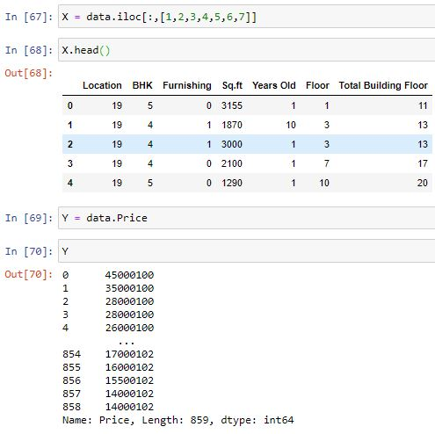
Datasets Processing
Setting values to any of the Independent Variables as in to Train the Data.
For Example – X & y

Slide 10
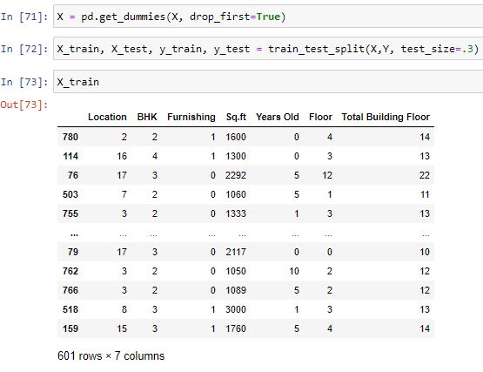
Datasets Processing
Split the Total Dataset to Train & Extract a Model as Test & Train Datasets.
Notes:
In a dataset a training set is implemented to build up a model, while a test (or validation) set is to validate the model built.

Slide 11
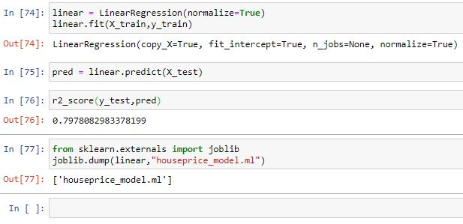
Datasets Processing
We are using Linear Regression to Predict the House Price.
Notes:
Joblib is optimized to be fast and robust on large data in particular and has specific optimizations for numpy arrays.
Joblib is a set of tools to provide lightweight pipelining in Python.
easy simple parallel computing.
transparent disk-caching of functions and lazy memorize pattern.
R-squared (R²) is a statistical measure that represents the proportion of the variance for a dependent variable that's explained by an independent variable or variables in a regression model

Slide 12
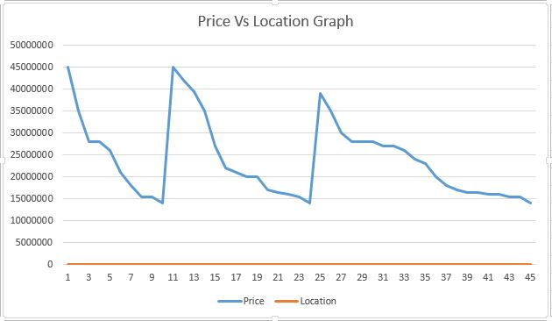
Sample Dataset Graph
This Graph depicts one of the Area a Customer wants to check the House Price

Slide 13
Linear Regression Model
To determine whether the effect of one independent variable depends on the value of another variable.
To predict the value of the Dependent variable against Independent variable.
Linear Regression Equation > Y = a + bX
Where X – Independent Variable & Y – Dependent Variable.
Notes:
Linear Regression a single independent variable is used to predict the value of a dependent variable.
It is used to determine the extent to which there is a linear relationship between a dependent variable and one or more independent variables.

Slide 14
Future Improvisation
Random Forest Analysis
It is a method of Classification. It is quite fast, Able to deal with unbalanced & missing data.
When it is used for Regression they cannot predict beyond the range in the training data & They may over fit the datasets.
Multiple Linear Regression
When dataset variables are more & To generate précised prediction.

Slide 15
Technologies & Tools
Technologies:
Python
PHP
JSON
Several External Library Packages
Tools:
Jupyter Notebook
Visual Studio Code
XAMPP
Microsoft Office

Slide 16
Architecture (Flow Diagram)
Houseprice_model.ml
Index.php
Prediction.php
Predict.py

Slide 17
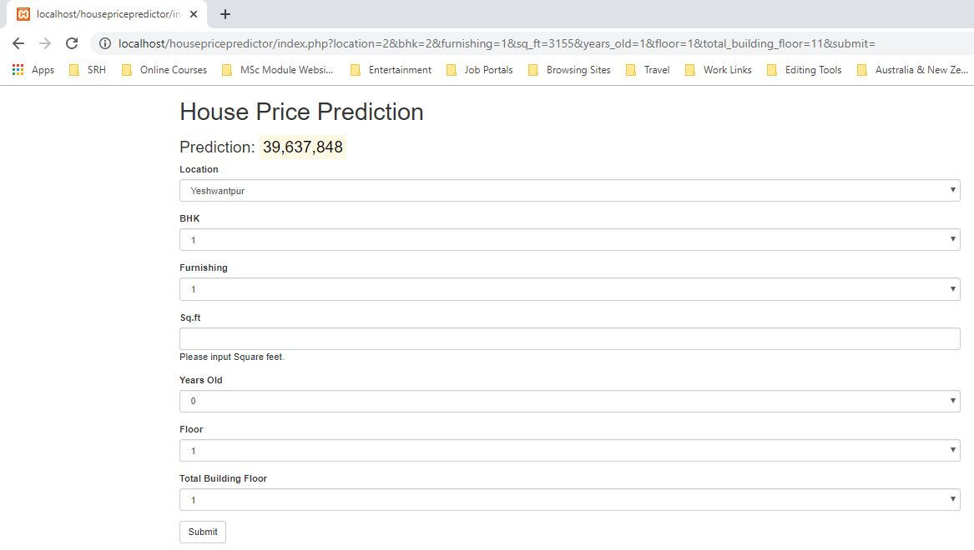
Sample Predicted Sale Price – Linear Regression

Slide 18
References
https://towardsdatascience.com
https://www.kaggle.com
https://archive.ics.uci.edu/ml/index.php
https://www.kaggle.com/subashdump/california-housing-price-prediction
https://towardsdatascience.com/machine-learning-predicting-house-prices-with-regression-2388bb876a6f

Slide 19
ANY QUESTIONS ?
THANK YOU

